Slide 1
SAP BTP Extension Suite Training
Day 5
Anubhav Oberoy
www.AnubhavTrainings.com
Follow excellence with sheer passion

Slide 2


DISCLAIMER
The training content and delivery of this presentation is confidential, and cannot be recorded, or copied and distributed to any third party, without the written consent of Anubhav Trainings

Slide 3
Agenda – Day 8
01
OData Adapter
02
Adding UI module
03
Deploy App to CF

Slide 4
































Odata Adapter

Slide 5
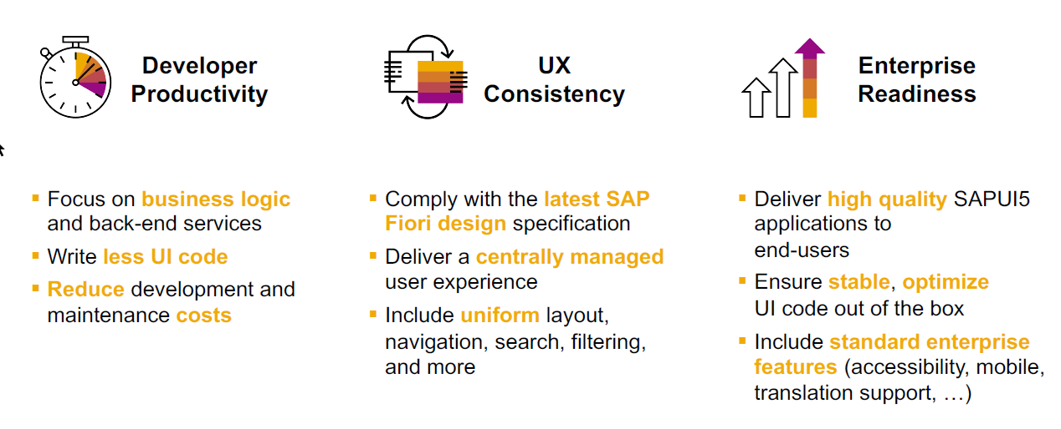
SAP Fiori elements boosts SAP Fiori development efficiency

Slide 6
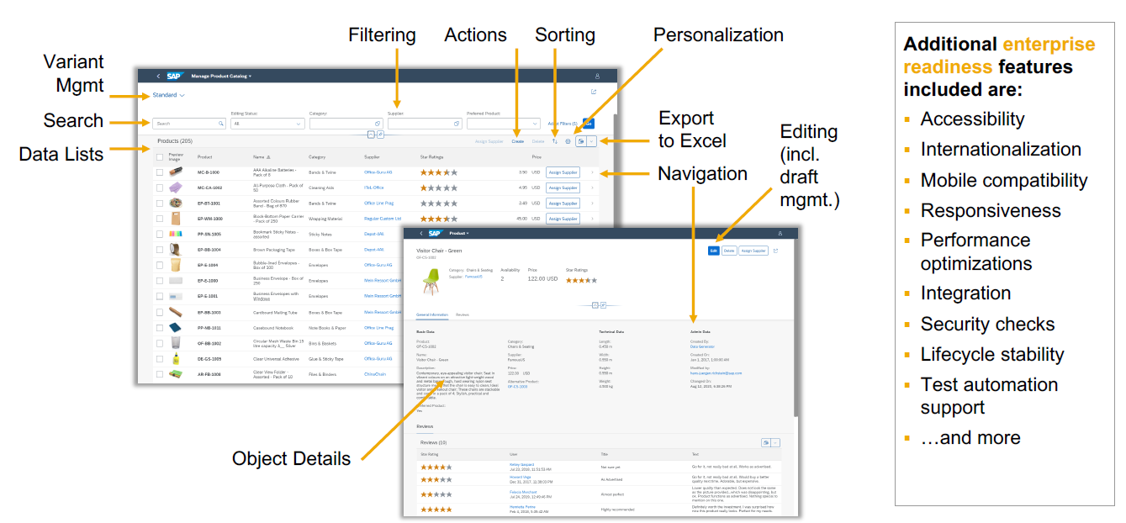
SAP Fiori elements provides enterprise-ready apps out of the box

Slide 7
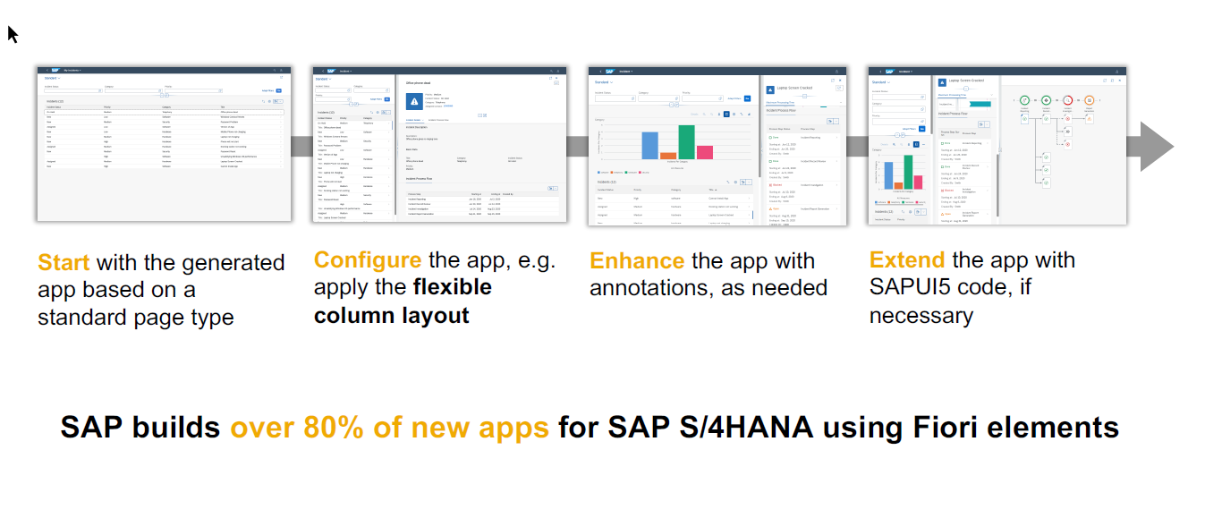
SAP Fiori elements application architecture provides flexibility

Slide 8
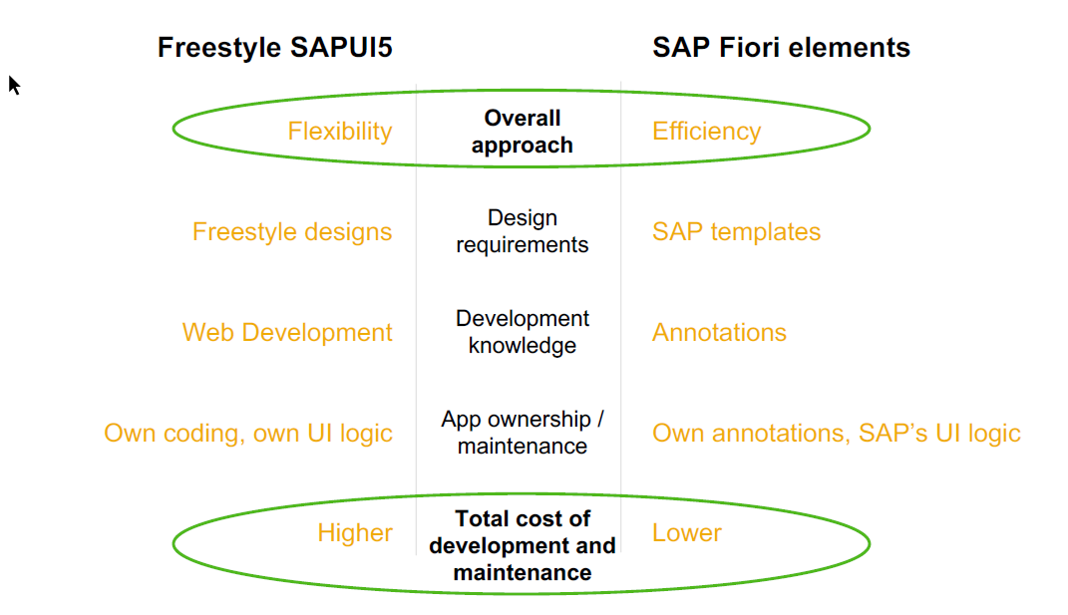
SAP Fiori elements prioritizes efficiency over flexibility

Slide 9

Hands on : Fiori App

Slide 10




















Slide 11












Annotations
@UI.SelectionField – selection fields
@UI.HeaderInfo – for title of the table
@UI.LineItem – Create columns of the table

Slide 12































Slide 13





















Slide 14
Create Fiori App using Annotation
Exercise:
https://github.com/soyuztechnologies/SAP_BTP_Training_CLD200/blob/master/Day%203/03%20application/03application/app/purchaseorderapp/annotations.cds

Slide 15
Association v.s Composition
Association – a relationship between entities which is a lose coupling. Both objects should exist together. However, they can work independently. Airplane and passenger.
Composition – a relationship between entities which is a tight coupling. Both objects must exist together. They cannot function independently. Airplane and wings.
Purchase Order Header
composition
Purchase order Items

Slide 16

Hands on: Create & F4 Enablement for app
Solution: https://github.com/soyuztechnologies/SAP_BTP_Training_CLD200/tree/master/Day%204/capm%20draft%20and%20value%20helps

Slide 20

What We Did
Let’s Summarize

Slide 21

www.anubhavtrainings.com
Thank You
End of Day 5

Slide 22


We’re committed to empower you to be
#FutureReady
through powerful training solutions.
We build the workforce of the future.
250+
Corporate Clients
50,000+
Learners Trained
25000+
Learners Placed
FREE WEBINARS
Sign up for free webinars with industry experts every fortnight!
Enroll Now!
Contact us today!
https://anubhavtrainings.com

Slide 23
Agenda – Day 4
01
04
Introduction to HANA Cloud
Identity Provider
02
05
Connecting to HANA Cloud Instance
JWT Token and Application Router
03
06
Authentication v/s Authorization
Deploy App to CF

